Slide 1
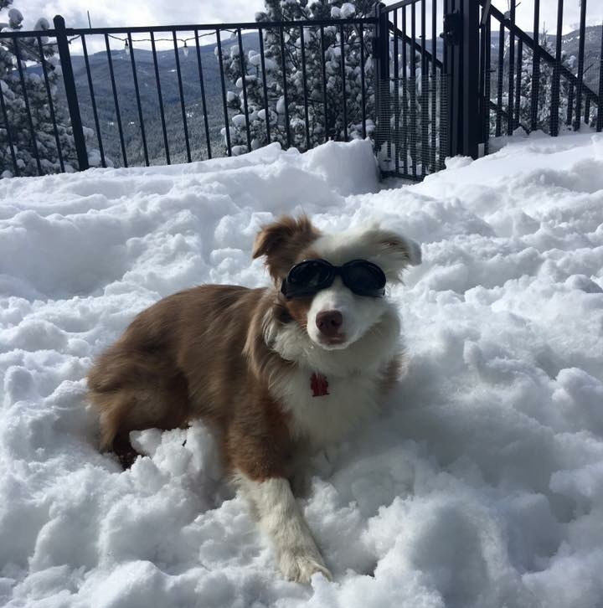

00 | U-SQL Instructor Led Lab
Todd Barron & Jonathan Caplan | Sr. Solution Architects, RedPoint Global

Slide 2
Introduction
U-SQL is the Big Data query language of the Azure Data Lake Analytics (ADLA) service.
U-SQL evolved from an internal Microsoft Big Data query language named SCOPE. It combines a familiar SQL-like declarative syntax with the extensibility and programmability provided by C# types and the C# expression language, together with support for Big Data processing concepts such as "schema on reads", custom processors and reducers.
U-SQL is not ANSI SQL, nor is it Transact-SQL. For starters, its keywords such as SELECT have to be in UPPERCASE. U-SQL uses the C# type system and within SELECT clauses, WHERE predicates, and so on, U-SQL uses C# expressions. This means the data types are C# types and use C# NULL semantics, and the comparison operators within a predicate follow C# syntax (e.g., a == "foo").

Slide 3
How
Batch Scripting
Retrieve data from stored locations in rowset format. These stored locations can be:
Files that will be schematized on read with EXTRACT expressions.
U-SQL tables that are stored in a schematized format.
Transform the rowset(s).
You can compose script multiple transformations over the rowsets in an expression flow format.
Store the transformed rowset data. You can:
Store it in a file with an OUTPUT statement.
Store it in a U-SQL table.

Slide 4
Prerequisites
To complete this lab you'll need:
A copy of Visual Studio with the Azure Data Lake Tools for Visual Studio installed, or access to the ADLA Portal.
Access to an ADLA account.
Access to an Azure Data Lake Store (ADLS) account.
The lab exercises that follow provide only the language and scripts, and will not show you how to use the Azure Data Lake Tools for Visual Studio or the Azure Data Lake Analytics Portal. Your instructor will show you how to run the scripts through Azure Data Lake Tools for Visual Studio and/or the Azure Data Lake Analytics Portal.

Slide 5
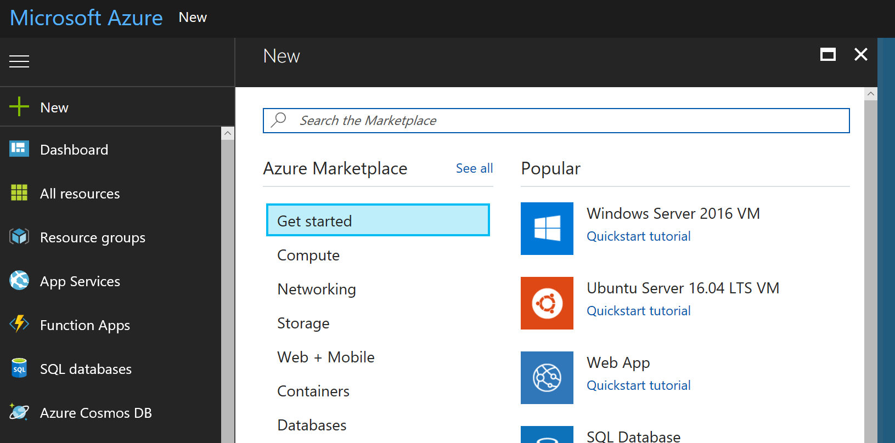
Setup Azure
http://portal.azure.com
Create Resource Group
Create Data Lake Storage
Create Data Lake Analytics
Copy Sample Scripts/Data (Under Sample Scripts)
Samples are not installed by default to save on charges
https://github.com/Azure/AzureDataLake/blob/master/docs/Hands_on_Labs/USQL_HOL.md

Slide 6
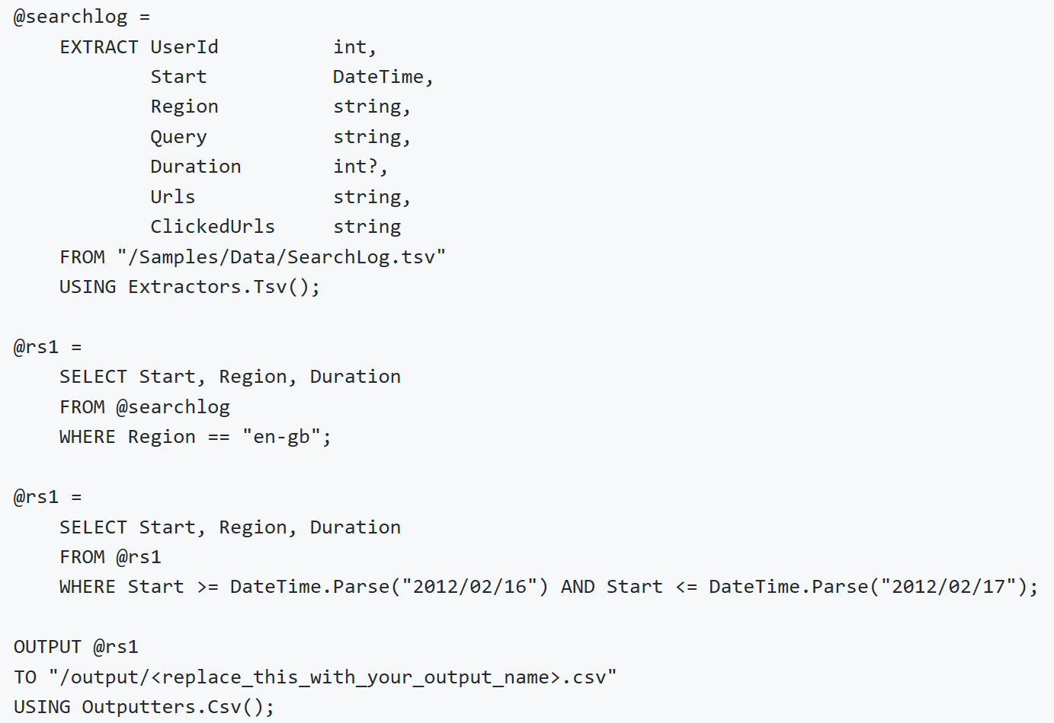
Key Concepts
Sample data is tiny
Scaling the # of processors will not improve performance but will cost more
U-SQL does not process line-by-line
Code combined
@rs1 SELECT code is combined into a single SELECT, not executed in two parts
Processes combined
Compiler will see the same SELECT across the script and execute it only once

Slide 7
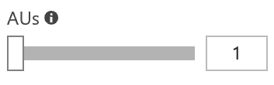
Key Concepts
Scripts can be scaled via multiple AUs
Does not utilize them intelligently, do not arbitrarily set
Our exercises are ok with 1-4
Can be slower if scale too high, due to setup time

Slide 8
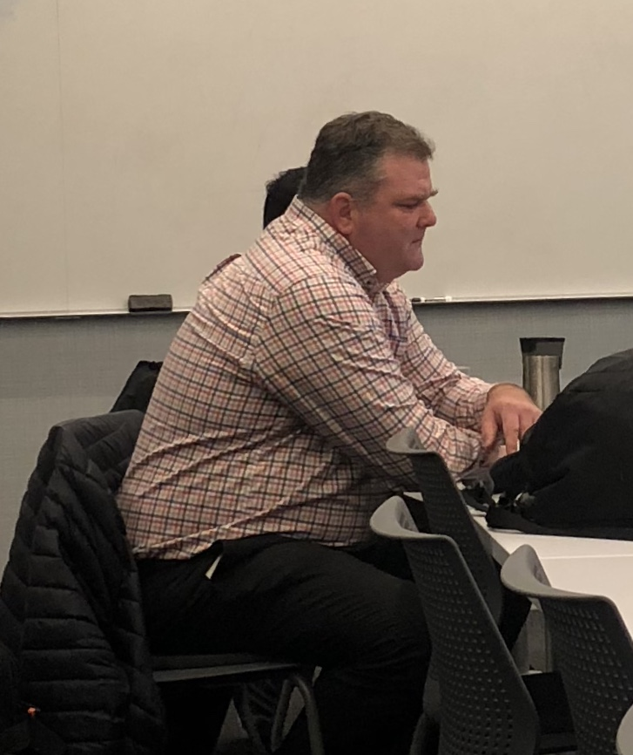
Need Help?
ASK ANDY!

Slide 9
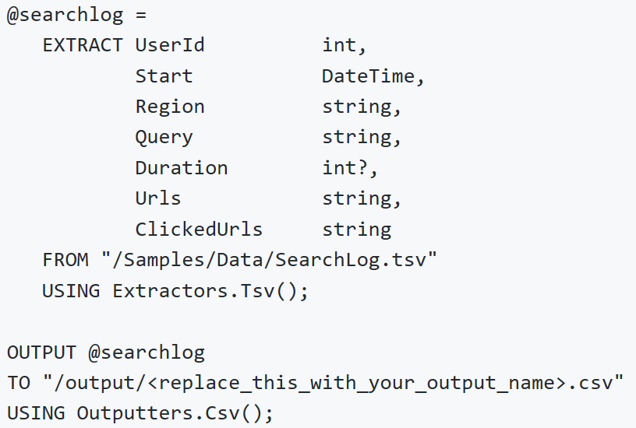
Exercise 1
In this exercise you will submit a U-SQL script that reads data from an input file, extracts and schematizes data, and writes the results into an output file
Navigate to ADLA account
+ New Job
Copy/Paste Code
@ sets variables
SELECT and EXTRACT used interchangeably
? Allows for NULLable integer
Uses TSV Extractor, can write your own
Uses CSV Writer, same as extractors
Submit Job

